Slide 1
Particle Swarm Optimisation for Neural Networks
4G4 Group Presentation
Group 8: Kim Barker, Louise Aumont and William Halfpenny
Notes:
LOUISE
https://www.howitworksdaily.com/wp-content/uploads/2015/07/wallpaper-of-a-flock-of-flying-birds-hd-bird-wallpapers.jpg

Slide 2
Presentation Outline
Motivation
Results
Future steps
Notes:
LOUISE
1min
https://www.wired.com/wp-content/uploads/images_blogs/wiredscience/2013/03/ff_collectives2_large.jpg

Slide 3
1. Motivation

Slide 4
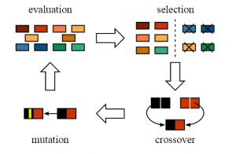
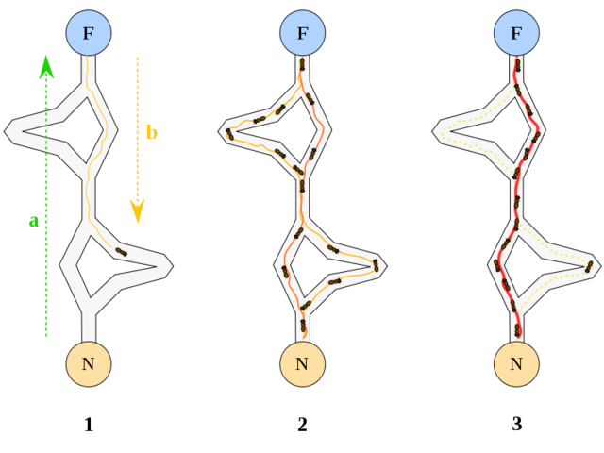
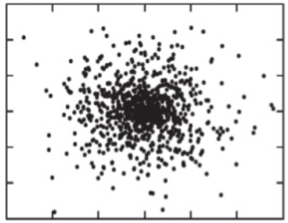
Biomimetic Algorithms
Natural metaphors
More intuitive algorithms
Notes:
Biomimetics takes inspiration from nature
This is a major advantage for bio-inspired algorithms as by definition they have a natural metaphor in nature and a concept we are already familiar with.
this means that they are much easier to understand without a strong mathematical background.

Slide 5

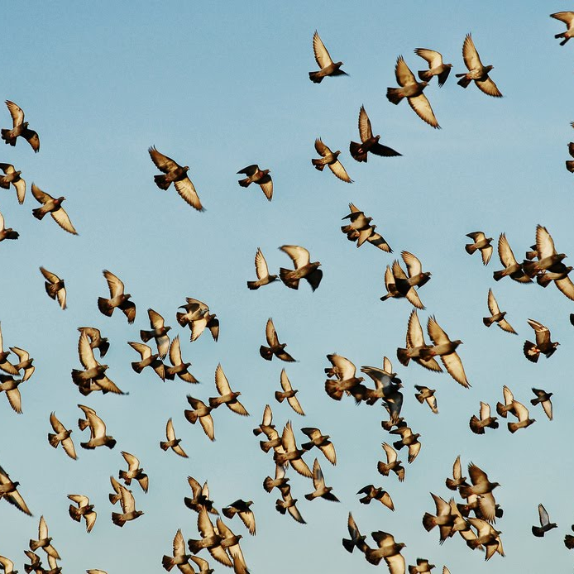
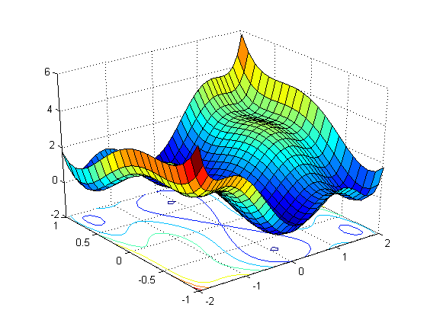
Particle Swarm Optimisation
Particle Swarm Optimisation (PSO)
Inspired by flocking behaviour of birds
Updates based on of global and personal history
Notes:
One such example of this is particle swarm optimisation or PSO
Swarm intelligence where lots of simple homogeneous entities use local interactions to carry out complex tasks as a group
PSO takes inspiration flocking behaviour
The entities or particles, try to find an optimum using knowledge of both their personal history and swarm history.
PSO is a commonly used optimisation algorithm for a range of problems today.

Slide 6
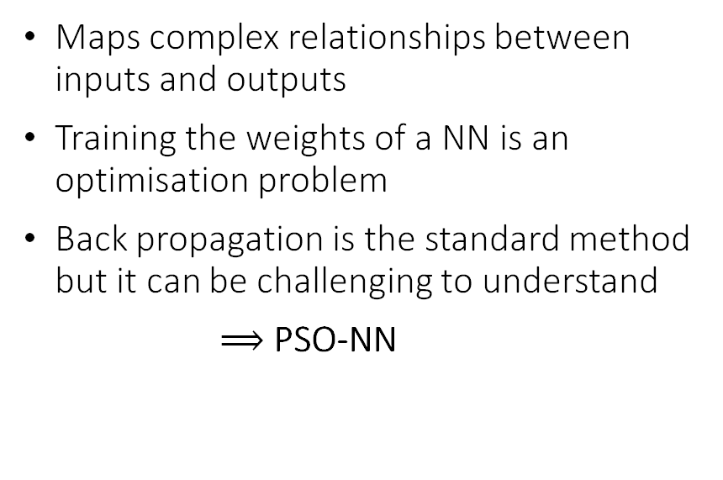
Neural Network Training
Maps complex relationships between inputs and outputs
Training the weights of a NN is an optimisation problem
Back propagation is the standard method but it can be challenging to understand
$⟹$PSO-NN
Notes:
We’re going to look at how we can apply PSO to artificial neural networks.
ANNs are another biomimetic example inspired by biological networks in the brain with nodes representing neurons and connections representing synapses.
Neural networks a valuable tools for mapping complex relationships between large input and output datasets and have increasingly important applications.
Training the NN purely is an optimisation problem to find the best weights of connections for the input to output mapping
But current de-facto training method back propagation is mathematically complex and not very intuitive to understand
Therefore we want to explore if PSO can be used for this training as it is simply an optimisation task

Slide 7
Problem Statement
“How does PSO compare to conventional methods for training NNs?”
Is it as accurate?
Is it as efficient?
Is it robust?
Will it work on complex datasets?
Notes:
Therefore our problem statement.
If we find PSO is a viable alternative to neural network training, this could provide a much simpler and more intuitive alternative to the conventional BP method.

Slide 8
2. Results and Insights

Slide 9
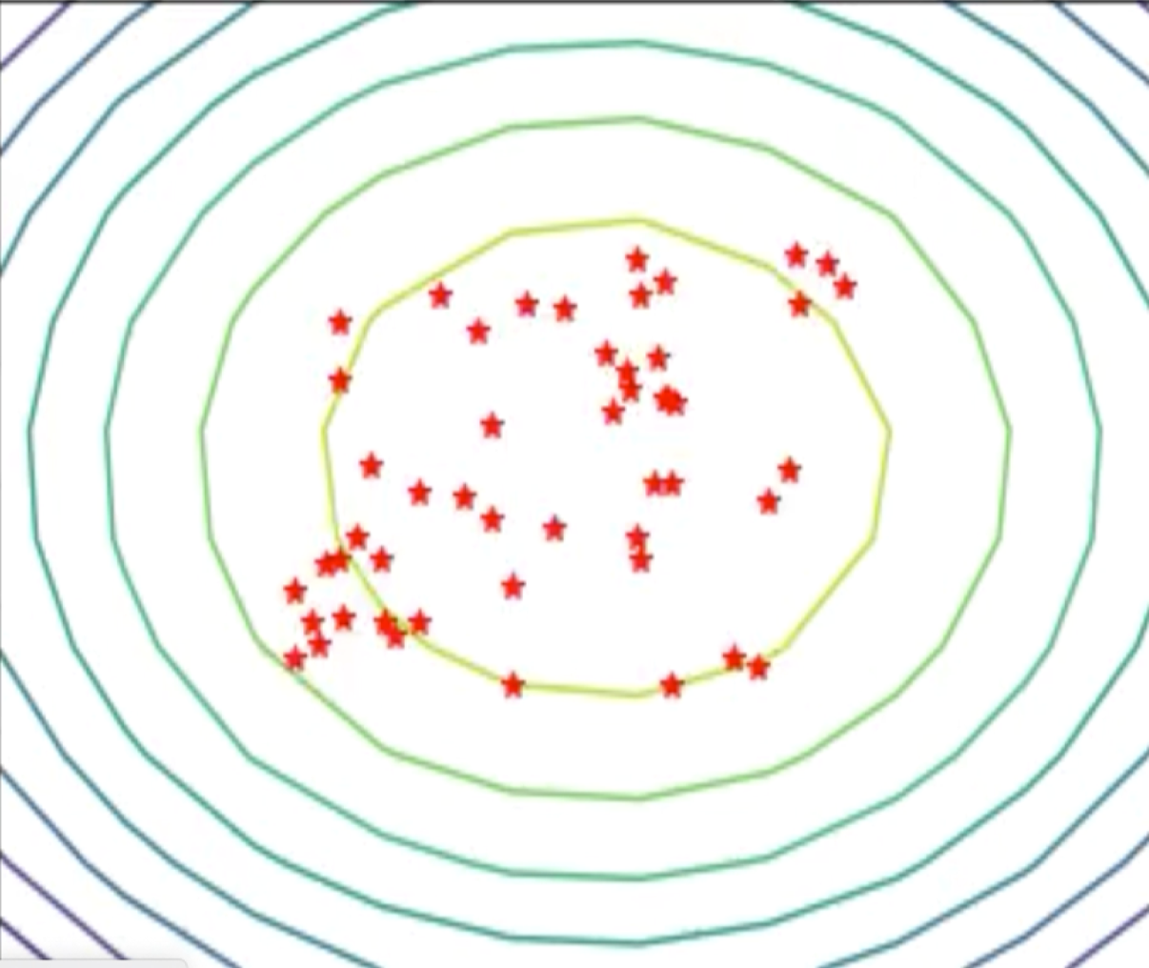
Simulating PSO
2D simulation: visual and intuitive
Set the initial position and velocity
Update them at each iteration:
Cognitive term
Social term
Notes:
LOUISE
We first coded our own PSO simulation in 2D because it’s visual and intuitive to understand
We placed these red particles with random initial positions and velocities in this 2D map of our objective function
At each iteration of our algorithm, we then update every particle’s position and velocity using these equations
The new velocity is: previous velocity + the cognitive term, which is a vector pointing towards the position of the particle’s best optimum so far and the social term, which is a vector pointing towards the position of the swarm’s best optimum to date
C1 and c2 can be tuned to make the particles more cognitive or social
Moreover if they are large, the particle acceleration will be large and the particles will explore the space quickly, whereas if they are small the particles will conduct a refined search in a small area
Finally R1 and R2 randomise particles’ individual behaviour
As you can see the position is simply updated by adding the velocity vector to the previous position of the particle
Simulated PSO in 2D because it is intuitive
- Function is mapped in 2D and we are looking for the optimum
- Particles are placed with random positions and velocities in this space.
- We then update them at each iteration of the algorithm.
- Velocity update: previous velocity + cognitive term (depends on the particle’s distance to the position where it found its personal best optimum) and social term, which depends on the particle’s distance to the point of the swarm’s best optimum
- Refine best known results or explore unknown positions in the space to find better results
Go through equations in detail
v: velocity
x: position
R₁ and R₂: randomness
c₁, c₂: determine how
Exploration (large) vs exploitation (small)
Ratio: cognitive (c₁ > c₂) vs social (c₁ < c₂)
The PSO algorithm iteratively searches for the global minimum of a function in an multi-dimensional space.
The algorithm is initiated by randomly placing many particles, with random velocities, in the search space.
At each step, every particle’s velocity is updated according to its previous velocity, its historically best position and the global optimum amongst all the particles.
Over time, the particles will search the space and converge to the optimal point evaluated, using a given fitness criterion.
The constants c1 and c2, are used to balance the exploration and exploitation of positions by the particles. Higher values of c1 and c2 lead to a more exploratory nature, with particles moving greater distances in each iteration and hence exploring further through the search space. Lower values lead to a more refined search near the current best positions.
The relative values of c1 and c2 also allow us to balance the relative importance of the particle’s individual history with that of the entire swarm.
We refer to (pi(t) xi(t)) as the cognitive term representing local memory, and pg(t) xi(t) as the social term representing the group knowledge. For c1 > c2, the swarm will be more biased to the cognitive term, whereas for c2 > c1, the bias is towards the social term.
In the original PSO algorithm, c1 = c2 = 2, giving an equal balance between each. This value of 2 is given to account for the average of the diagonal entries in R1 and R2 being 0.5. Recent versions of PSO have varied the relative values of c1 and c2 to improve control of the search ability. The values typically fall in the [0, 4] range with the constraint c1 + c2 = 4.
We refer to the velocity at the previous time-step vi(t) as the inertia of the particle. This ensures that a particle’s velocity changes gradually, and it is able to maintain some momentum in its trajectory. This term is particularly. important where a particle reaches a position that is the global best, as in the case where xi = pi = pg, and the social and cognitive terms will both be equal to zero. This means that this particle’s velocity will remain constant, and it will continue with its current momentum. However if we neglected to take momentum into account the particle would no longer move and remain “trapped” in the same position until the next global optimum is found.
These update steps occur until some termination criterion is satisfied (e.g., convergence, maximum number of iterations, minimum fitness value reached). The full implementation for PSO is outlined in Algorithm 1.

Slide 10
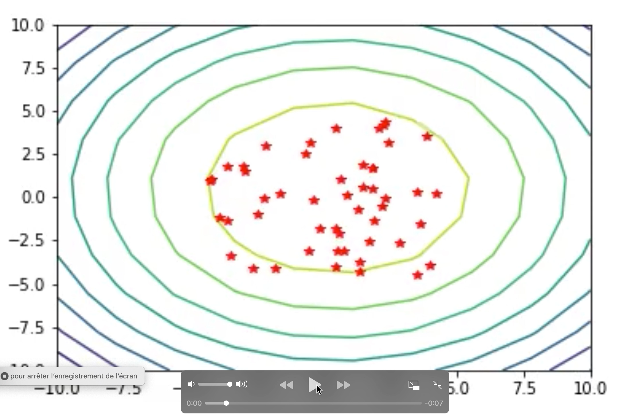
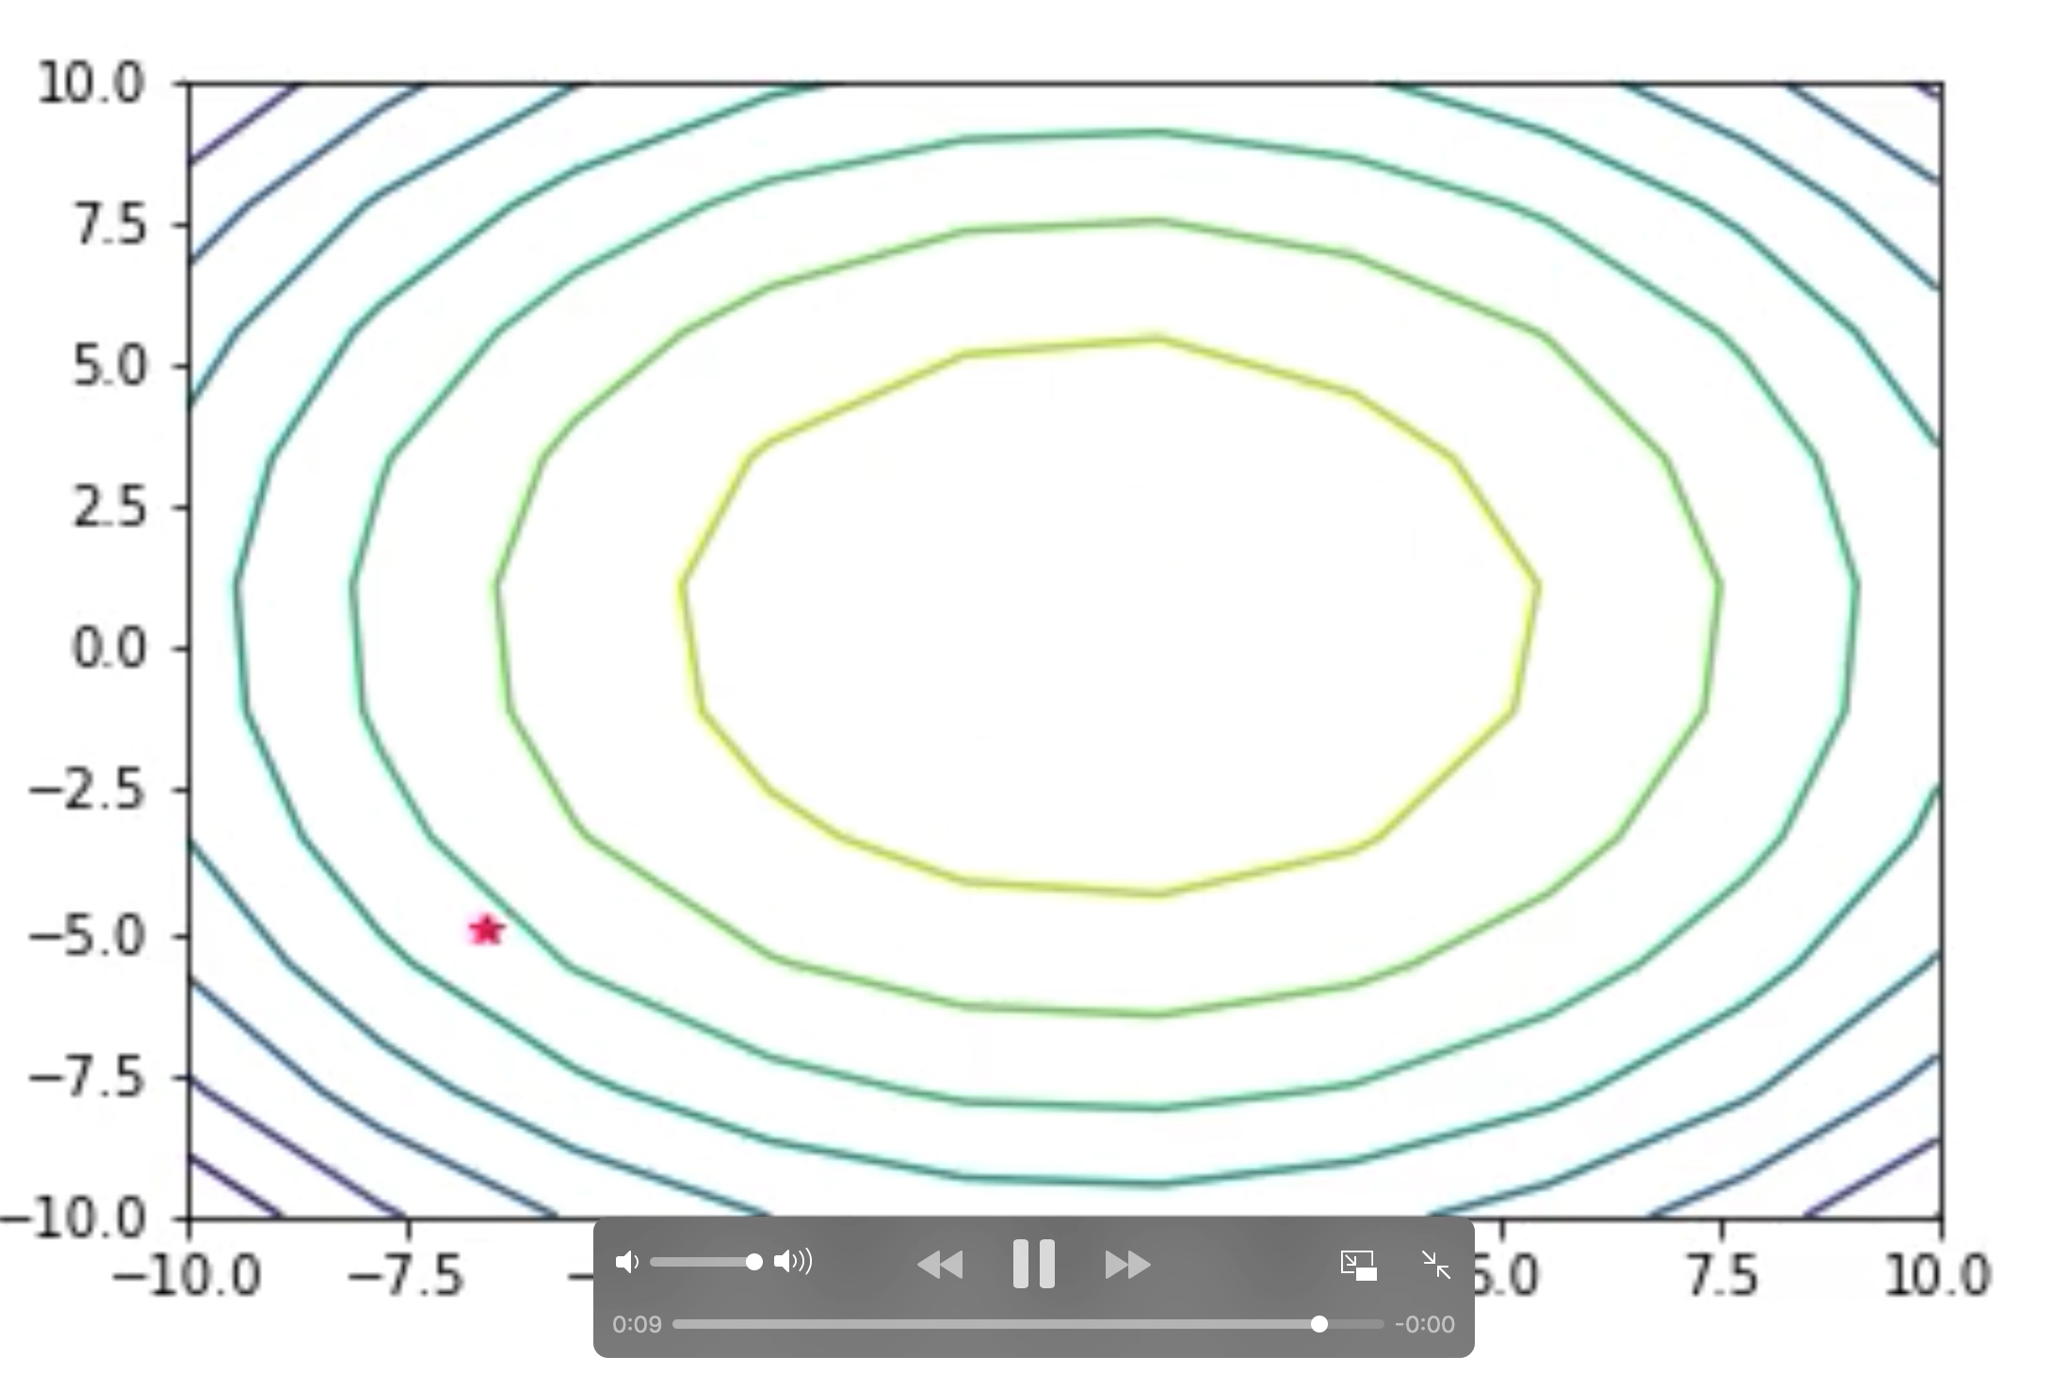
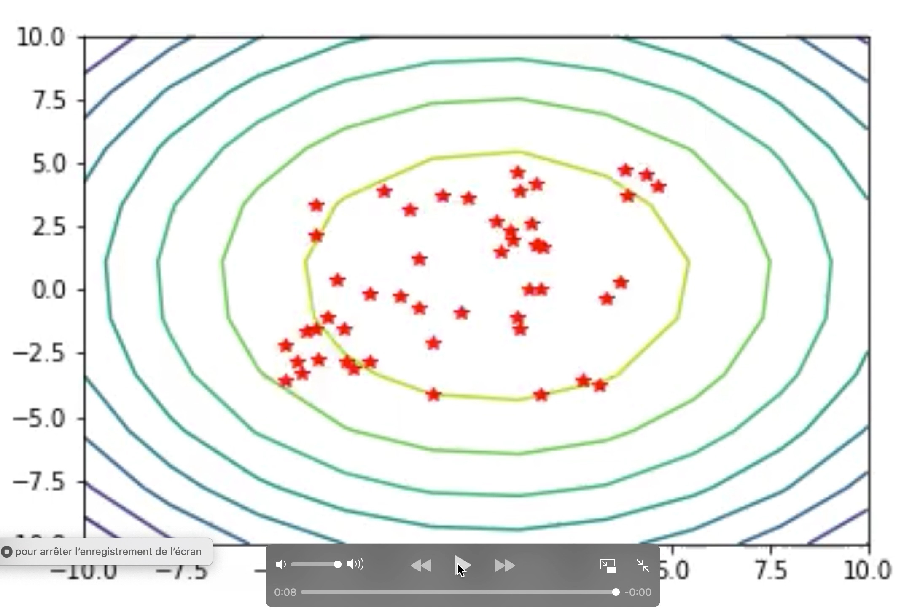
Experimenting with Parameters
Velocity range
Accuracy vs efficiency
Small v_{max}
Large v_{max}
Well chosen v_{max}
Notes:
LOUISE
We have been experimenting with all the parameters I just mentioned to tune PSO to each optimisation task we have tackled.
One of these parameters is the particles’ maximum velocity Vmax.
If the maximum velocity is too small particles converge to the optimum but efficiency is compromised.
On the other hand if it’s too large particles might skip over the optimum and miss it entirely.
Vmax is chosen empirically to match the requirements of the problem at hand.

Slide 11
PSO-NN
How do we find f(x)?
x = [
]
3.7
2.3
Often:
x = [
]
2
3
1
0
3
2
5
7
4
…
Notes:
Optimization is done in exactly the same way as before.
Have a bunch of points in space.
Every dimension corresponds to a weight in a neural network
First step: what is the value of the function at a point?
* What is the function

Slide 12
x = [
]
2
3
1
0
3
2
5
7
4
3
9
5
5
4
6
3
2
4
7
8
9
8
0
0
1
3
2
5
3
4
7
5
Notes:
[Intermediate slide]

Slide 13

x = [
]
2
3
1
0
3
2
5
7
4
3
9
5
5
4
6
3
2
4
7
8
9
8
0
0
1
3
2
5
3
4
7
5
Training inputs
f(x)
Predictions
Notes:
Every dimension corresponds to a weight in a neural network
Training inputs are then put in, which generates predictions of the output.
Objective function is calculated by comparing these predictions to the true value.

Slide 14
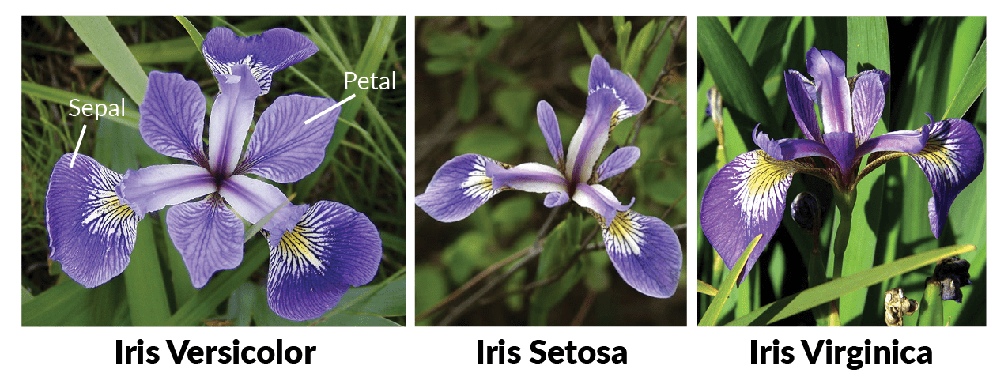
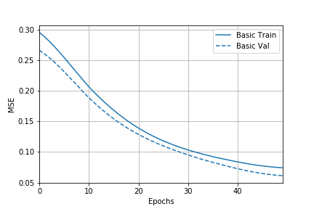
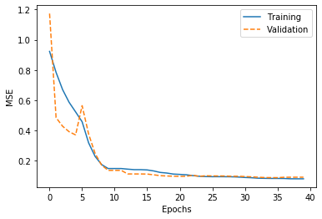
Results
Backpropagation results
Accuracy = 93.333%
PSO Results
Accuracy = 90.000%
Notes:
We simulated our network using Python with the tensorflow library.
* Iris dataset which is a simple classification task that takes 4 numerical inputs and returns one of three flower type labels.
***SHOW GRAPHS***
***Iterations not epochs***
https://upload.wikimedia.org/wikipedia/commons/thumb/9/9e/Iris_sanguinea.JPG/1200px-Iris_sanguinea.JPG

Slide 15
3. Conclusion and future steps

Slide 16
Future Steps
1. Quantify effects of:
Velocity limitation
Velocity decay
Fixed hyperparameters
2. Investigate generalisation to different data sets:
MNIST
CIFAR-10
PSO
Complexity
Decay c₁ and c₂
Limit velocity
Original PSO
Iris
MNIST
CIFAR-10
Custom
Dataset complexity
Notes:
Our aim is to find out if we could use swarm optimization as an outreach resource.
How far can we go without compromising?
[graph]
If it works: share our animations and python library to have us a learning resource.
Quantify effects of:
Velocity limitation
Velocity decay
Fixed hyperparameters (v_{max}, c₁/c₂, n_{particles}, decay rate)
Investigate generalisation to different data sets:
MNIST
CIFAR-10
Depending on results:
Open-source software for understand NN optimization

Slide 17
References
https://www.howitworksdaily.com/wp-content/uploads/2015/07/wallpaper-of-a-flock-of-flying-birds-hd-bird-wallpapers.jpg
https://www.wired.com/wp-content/uploads/images_blogs/wiredscience/2013/03/ff_collectives2_large.jpg
https://image.slidesharecdn.com/studyofusingparticleswarmforoptimalpowerflow-140804204246-phpapp02/95/study-of-using-particle-swarm-for-optimal-power-flow-19-638.jpg?cb=1407185033
https://www.analyticsvidhya.com/blog/2017/07/introduction-to-genetic-algorithm/
http://www.collective-behavior.com/wp-content/uploads/2016/03/ant_colony_optimization.png
https://mag.uchicago.edu/sites/default/files/1508_Kelly_Neural-network.jpg
http://slideplayer.com/slide/9347431/28/images/1/Artificial+Neural+Network.jpg
https://upload.wikimedia.org/wikipedia/commons/thumb/9/9e/Iris_sanguinea.JPG/1200px-Iris_sanguinea.JPG

Slide 18
Particle Swarm Optimisation for Neural Networks
4G4 Group Presentation
Group 8: Kimberly Barker, Louise Aumont and William Halfpenny
Notes:
LOUISE
https://www.howitworksdaily.com/wp-content/uploads/2015/07/wallpaper-of-a-flock-of-flying-birds-hd-bird-wallpapers.jpg

